Slide 1
Forecasting Analytics
Session 3

Slide 2
Components of a time series
Components
Regular
Trend
Seasonal component
Irregular
Random component
Cyclic component

Slide 3
Typical models
Additive model
Y_{t} = T_{t} + S_{t} + C_{t} + I_{t}
Multiplicative model
Y_{t} = T_{t} × S_{t} × C_{t} × I_{t}
log(Y_{t})= log(T_{t}) + log(S_{t}) + log(C_{t}) + log(I_{t})
A multiplicative model can be regarded as an additive model for log-transformed time series.

Slide 4
Forecasting strategy
Forecast each part separately
Forecasting of regular components is easier
Need to decompose/extract different parts
Steps
Separate
Forecast
Combine
Cyclic component is often most difficult to handle
Long-term cyclic movements may come to be clubbed with trend in a decomposition process

Slide 5
Decomposition with R
Splits data into trend, seasonal component and random components
Only one seasonal component can be handled
Smoothing is used to extract trend
Long-term cyclic movements get clubbed with trend
Short-term cyclic movements get clubbed with random component

Slide 6
R code for decomposition of US retail sales data (Case 3-1A)
For additive decomposition
library("TTR")
Tab31A <- scan("c://Hanke/Data_Files/ascii/Ch03 /Case3-1A.txt",skip=1)
Tab31Ats <- ts(Tab31A, frequency=12, start=c(1983,1))
Tab31ACompAdd <- decompose(Tab31Ats)
plot(Tab31ACompAdd)
For multiplicative decomposition
Tab31ACompMult <- decompose(Tab31Ats, type = "multiplicative")
plot(Tab31ACompMult)

Slide 7
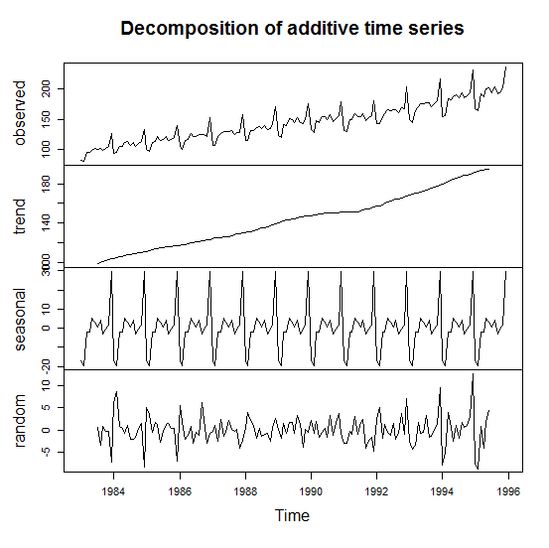
Additive decomposition produced by R

Slide 8
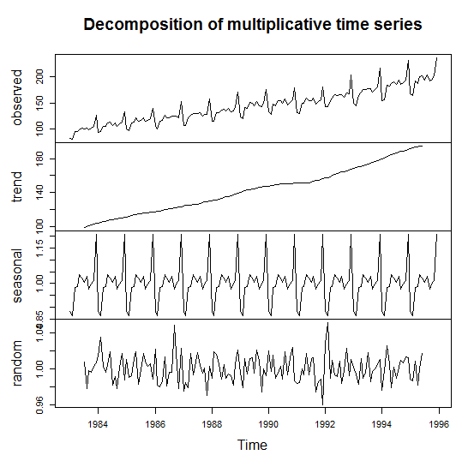
Multiplicative decomposition produced by R

Slide 9
Generating forecasts after Adjusting for trend through differencing
‘Difference’ original series
W_{t} = Y_{t} – Y_{t – 1}
Model it; generate fit/forecast it (Ŵ₁, Ŵ₂,…, Ŵ_{n}, Ŵ_{n+1} etc.)
Forecast original series
Ŷ_{t} = Ŷ_{t – 1} + Ŵ_{t} for t > n+1
Ŷ_{t} = Y_{t – 1} + Ŵ_{t} for t < n+2
A second round of differencing is also possible (need to be ascertained through time plot)

Slide 10
Adjustment for trend through explicit modeling
Split time series into trend and ‘other’ parts
Y_{t} = T_{t} + W_{t}
Model W_{t}; Generate ‘forecasts’ (Ŵ₁, Ŵ₂,…, Ŵ_{n}, Ŵ_{n+1} etc.)
Model T_{t}; Generate ‘forecasts’ (Ť₁, Ť₂,…, Ť_{n}, Ť_{n+1} etc.)
Put everything together
Ŷ_{t} = Ť_{t} + Ŵ_{t}
T_{t} may be modeled directly from Y_{t} also.
For multiplicative situation, use log transform

Slide 11
Modeling of trend
Smooth the original time series
Moving average with high k
Exponential smoothing with small α
Fit a curve to the trend component or to the original series
Linear curve
Quadratic curve
Exponential growth curve

Slide 12
R code for fitting linear trend to US retail sales data (Case 3-1A)
For obtaining fit
time <- 1983 + (0:155)/12
ResidOrig <- lm(Tab31Ats~time)$resid
FittedOrig <- Tab31Ats - ResidOrig
plot.ts(Tab31Ats,ylab="Original series and fitted trend")
lines(time,FittedOrig,col="2")
For plotting residuals
plot(time,ResidOrig,type="l", ylab="Residuals of LS fit to original series")

Slide 13
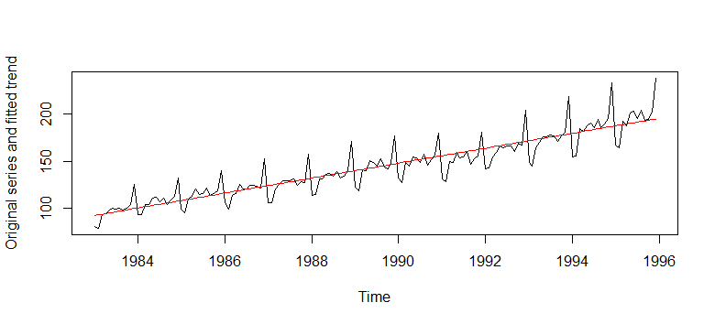
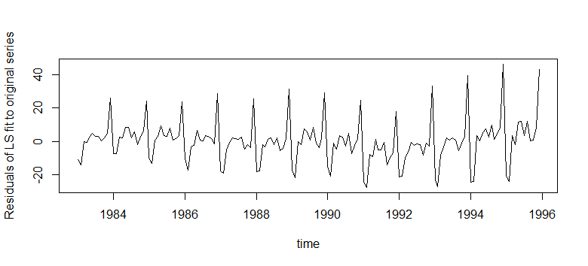
Line fit to US retail sales data and residuals

Slide 14
R code for fitting straight line to trend part of US retail sales data
For obtaining fit
ResidTrend <- lm(Tab31ACompMult$trend[7:150]
~time[7:150])$resid
FittedTrend <- Tab31ACompMult$trend[7:150] - ResidTrend
plot(time[7:150],Tab31ACompMult$trend[7:150], ylab="Trend component and linear fit",type="l")
lines(time[7:150],FittedTrend,col="2")
For plotting residuals
plot(time[7:150],ResidTrend,type="l", ylab="Residuals of LS fit to trend")

Slide 15
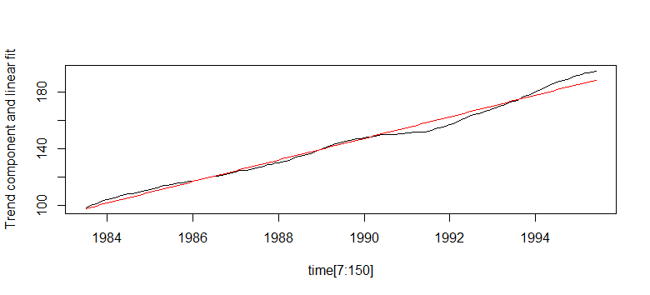
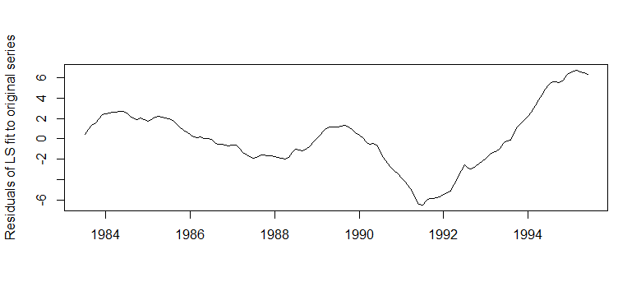
Line fit to US retail sales trend and residuals

Slide 16
Seasonal components
If the period length is s, identifying the seasonal component amounts to identifying s numbers that would indicate deviation from the mean
In an additive model, these components would be centered around 0
In a multiplicative model, these components would be centered around 1
Methods for identifying seasonal component range from simple averaging to calculations based on several steps of moving averages (see p.176-177 of text for details)
In the multiplicative model, the seasonal multipliers are called index numbers

Slide 17
Smoothing methods
Smoothing can be used for
Understanding the ups and downs in a time series, disregarding random fluctuations
Separating ‘trend’ from other components
Forecasting
There are two major approaches to smoothing
Moving averages
Exponential smoothing

Slide 18
Moving average models
Naïve model
Ŷ_{n + 1} = Y_{n}
Naïve trend model
Ŷ_{n + 1} = Y_{n} + (Y_{n} – Y_{n – 1})
Simple average model
Ŷ_{n + 1} = (Y₁ + Y₂ + … + Y_{n})/n
Moving average over k time periods
Ŷ_{n + 1} = (Y_{n} + Y_{n – 1} + … + Y_{n – k + 1})/k

Slide 19
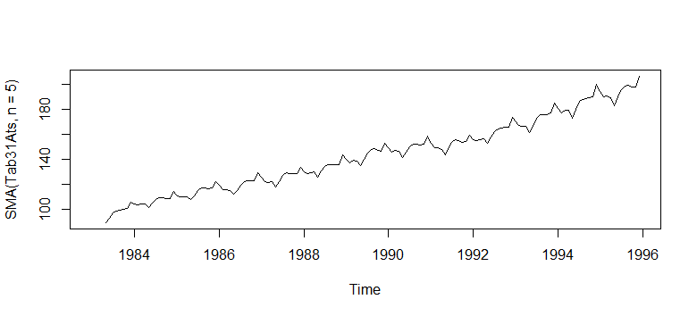
Moving average smoothing with R
R code
plot.ts(SMA(Tab31Ats,n=5))
Output

Slide 20
Exponential smoothing
Simple exponential smoothing
Ŷ_{t + 1} = αY_{t} + (1 – α) Ŷ_{t}
Holt’s version: includes a trend component
L_{t} = αY_{t} + (1 – α) (L_{t – 1} + T_{t – 1} )
T_{t} = β (L_{t} – L_{t – 1} ) + (1 – β) T_{t – 1}
Ŷ_{t + p} = L_{t} + pT_{t}
L_{t} : Local (current) level
T_{t} : Local (current) trend
α : Smoothing parameters for level
β : Smoothing parameters for trend

Slide 21
Exponential smoothing (contd.)
Winter’s modification: seasonal component
L_{t} = α (Y_{t} / S_{t – s}) + (1 – α) (L_{t – 1} + T_{t – 1} )
T_{t} = β (L_{t} – L_{t – 1} ) + (1 – β) T_{t – 1}
T_{t} = γ (Y_{t} / L_{t}) + (1 – γ) S_{t – s}
Ŷ_{t + p} = L_{t} + pT_{t}
L_{t} : Local (current) level
T_{t} : Local (current) trend
S_{t} : Local (current) seasonal component
α :: Smoothing parameters for level
β :: Smoothing parameters for trend
γ :: Smoothing parameters for seasonal component (can ::have s separate values for different seasons)

Slide 22
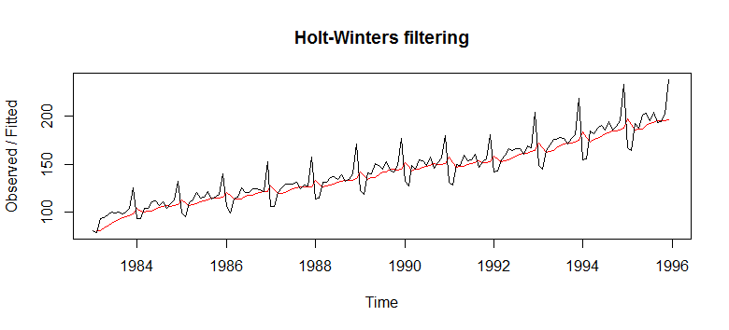
Exponential smoothing with R
R code
plot(HoltWinters(Tab31Ats, beta=FALSE, gamma=FALSE))
Output

